Slide 1

INTERNET OF THINGS BASESD AIR POLLUTION MONITORING
UNDER THE ESTEEMED GUIDENCE
OF
P.S. KEERTHANA
Assistant Professor, M.Tech.
Dept. of ECE
PRESENTED BY
Batch no: 14
K. MAHESH | (19NA1A0427)
V. VAMSI KRISHNA | (19NA1A0422)
SK. NISHITHA | (19NA1A0417)
V. AJAY | (19NA1A0433)
LINGAYA’S INSTITUTE OF MANAGEMENT AND TECHNOLOGY
(APPROVED BY AICTE- NEW DELHI, AFFILIATED TO JNTUK, ACCREDITED BY NAAC A GRADE)
MADALVARIGUDEM (V), VIJAYAWADA- -521 212.(Krishna District) [A.P.]

Slide 2

ABSTRACT
The problem of air pollution is a major global concern that affects human health, the environment, and the quality of life. Currently, traditional air pollution monitoring systems rely on fixed monitoring stations that can be limited in terms of accuracy, and real-time data availability. An IoT air pollution monitoring system using sensors and devices can gather more data from a wider area and provide real-time information to help reduce air pollution.

Slide 3
Objective
Real-time monitoring of air quality parameters, such as particulate matter harmful pollutants.
Providing accurate and reliable data on air Pollution levels to public, government and individuals.
Alerting authorities and citizens when pollution levels exceed certain thresholds, allowing them to take appropriate actions to reduce exposure to harmful pollutants.

Slide 4
KEYWORDS
ARDUINO
MICROCONTROLLER
HARDWARE
SOFTWARE
AIR POLLUTION MONITORING
DETECTING HARMFUL GASES
GSM
SENSORS

Slide 5
Introduction
Internet of Things-based air quality monitoring system, is a technology that utilizes a Network of sensors and connected devices to measure and monitor various air pollutants.
The primary goal of such a system is to provide real-time air quality data to help individuals, governments, and organizations make informed decisions about air pollution.
The sensors used in an IoT-based air pollution monitoring system are typically placed in strategic locations, such as near major sources of pollution, in populated areas, or in sensitive ecosystems.

Slide 6
LITERATURE SURVEY
Air pollution is a significant environmental issue that has negative impacts on both human health and the natural environment.
The problem arises from the release of harmful pollutants into the air from a variety of sources, including transportation, industry, and energy production.
These pollutants can have negative impacts on human health, causing respiratory and cardiovascular disease, as well as other health problems.

Slide 7
Hardware components required
ARDINO UNO
GSM( GLOBAL SYSTEM FOR MOBILE COMMUNICATION)
WIFI MODULE
LCD DISPLAY
MQ-2 SENSOR
MQ-5 SENSOR
MQ-135 SENSOR
MQ-7 SENSOR
MQ- 8 SENSOR
BMP 180 SENSOR
DHT11 sensor
BUZZER
EXASTING FAN

Slide 8
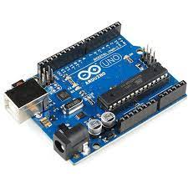
ARDUINO UNO
The Arduino Uno is a popular microcontroller board that is based on the ATmega328P microcontroller. The ATmega328P is an 8-bit microcontroller that has 32KB of flash memory for storing the program code, 2KB of SRAM for data storage, and 1KB of EEPROM for non-volatile data storage.
The ATmega328P also has 14 digital input/output pins, 6 of which can be used as pulse width modulation (PWM) outputs, and 6 analog input pins. The microcontroller can communicate using serial communication protocols like UART, SPI, and I2C.The Arduino Uno board provides a simple way to program the ATmega328P using a USB interface, and it also provides power to the microcontroller. The board has a variety of features that make it easy to use for beginners, such as a built-in LED and a reset button.
Fig. Arduino Uno ATmega328P

Slide 9
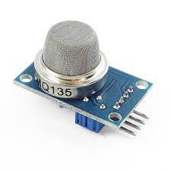
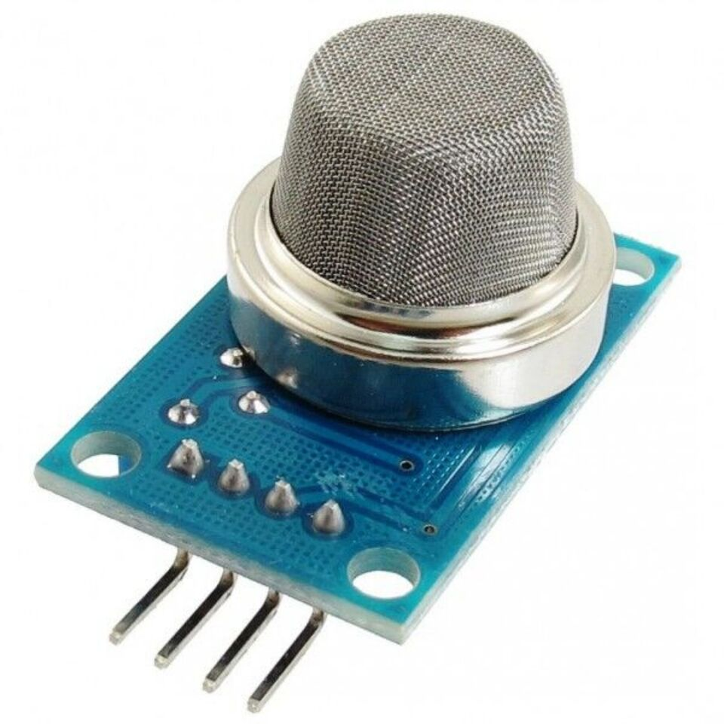
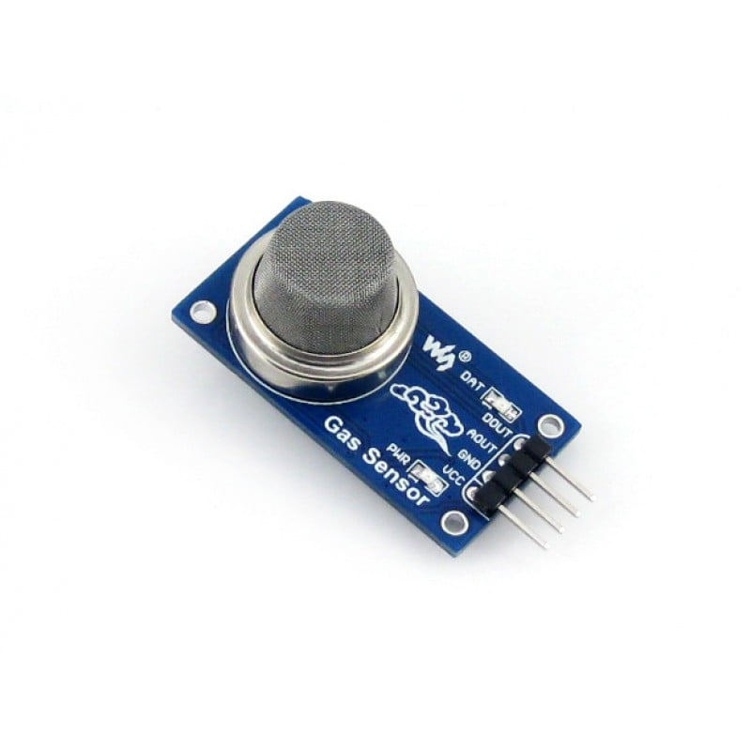
MQ 135 GAS SENSOR
MQ-135 is a gas sensor that is commonly used for detecting harmful gases such as ammonia, nitrogen oxides, benzene. The MQ-135 sensor has a low cost, good sensitivity, and quick response time, making it popular for use in air quality monitoring systems, industrial processes, and indoor air quality monitoring applications. It is important to note that MQ-135 is not suitable for detecting all gases and its sensitivity can be affected by temperature and humidity.
MQ-2 GAS SENSOR
MQ-2 is a gas sensor module that can detect a variety of gases including smoke, propane, methane, and carbon monoxide. The MQ-2 sensor module is commonly used in gas detection systems, gas leakage detectors, and in smoke detectors.
MQ-5 GAS SENSOR
MQ-5 is a gas sensor module that can detect a variety of gases, including natural gas, LPG (liquefied petroleum gas), and coal gas. The MQ-5 sensor module is commonly used in gas detection systems, gas leakage detectors, and in fire alarms.
Fig. MQ-135 Gas Sensor
Fig. MQ-2 Gas Sensor

Slide 10
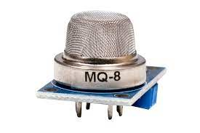
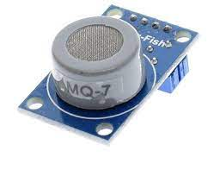
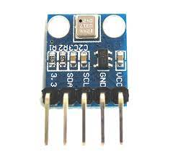
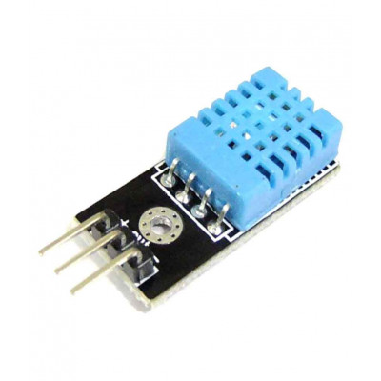
MQ -8 GAS SENSOR
MQ-8 is a gas sensor module that is designed to detect hydrogen gas (H2). The MQ-8 sensor module is commonly used in gas detection systems, hydrogen leak detectors, and in fuel cell monitoring applications.
MQ-7 GAS SENSOR
MQ-7 is a gas sensor module that is designed to detect carbon monoxide (CO) gas. The MQ-7 sensor module is commonly used in gas detection systems, smoke detectors, and in automotive applications to monitor the exhaust fumes
BMP 180 SENSOR
BMP180 is an atmospheric pressure sensor. The BMP180 sensor is mainly used to measure atmospheric pressure or biometric pressure. The working principle of the air pressure sensor is very simple it works on based on the weight of the Air. Because the air around us has a certain weight, and this weight has a specific pressure.
DHT-11 SENSOR
The DHT-11 Digital Temperature And Humidity Sensor is a basic, ultra low-cost digital temperature and humidity sensor. It uses a capacitive humidity sensor and a thermistor to measure the surrounding air and spits out a digital signal on the data pin .
Fig. MQ-8 gas sensor
Fig. BMP180 Sensor
Fig. MQ-7 gas sensor
Fig. DHT 11 Sensor

Slide 11
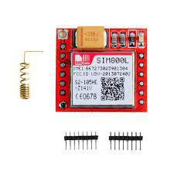
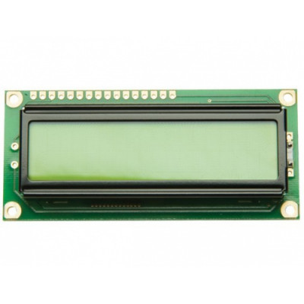
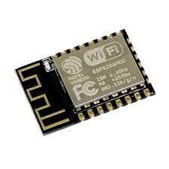
GSM MODULE
A GSM modem or GSM module is a device that uses GSM mobile telephone technology to provide a wireless data link to a network .GSM modems are used in mobile telephones and other equipment that communicates with mobile telephone networks. They use SIMs to identify their device to the network.
LCD DISPLAY
16x2 LCD means it can display 16 characters per line and 2 such lines. In this LCD each character is displayed in 5x7 pixel matrix. The 16 x 2 intelligent alphanumeric dot matrix display is capable of displaying 224 different characters and symbols. This LCD has two registers, namely, Command and Data
WI FI MODULE
Wi-Fi module is a type of wireless communication module that allows devices to connect to a wireless network and access the Internet or other network resources. WiFi modules typically use the IEEE 802.11 wireless networking standard and operate on the 2.4 GHz or 5 GHz frequency bands.WiFi modules come in different form factors, including embedded modules that can be integrated into other devices such as microcontrollers or single-board computers, and standalone modules that can be connected to devices through serial or USB interfaces.

Slide 12
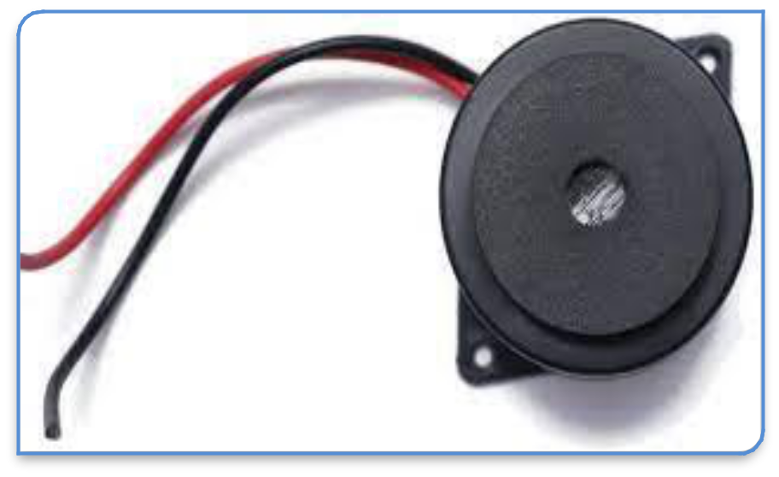
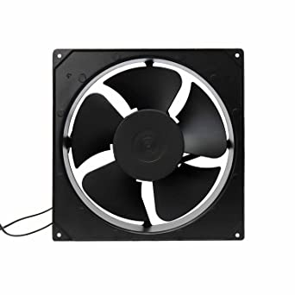
Buzzer
A buzzer or beeper is an audio signaling device, which may be mechanical, electromechanical, or piezoelectric (piezo for short). Typical uses of buzzers and beepers include alarm devices, timers, train and confirmation of user input such as a mouse click or keystroke.
Exhaust fan
They remove smoke and odors – we’ve all experienced the smoky dinner, or maybe you have a smoker in your home. Exhaust fans help to quickly remove smoke and odors, making your indoor air more breathable.
They help improve comfort – exhaust fans help maintain circulation and remove excess moisture, increasing your overall indoor comfort.

Slide 13

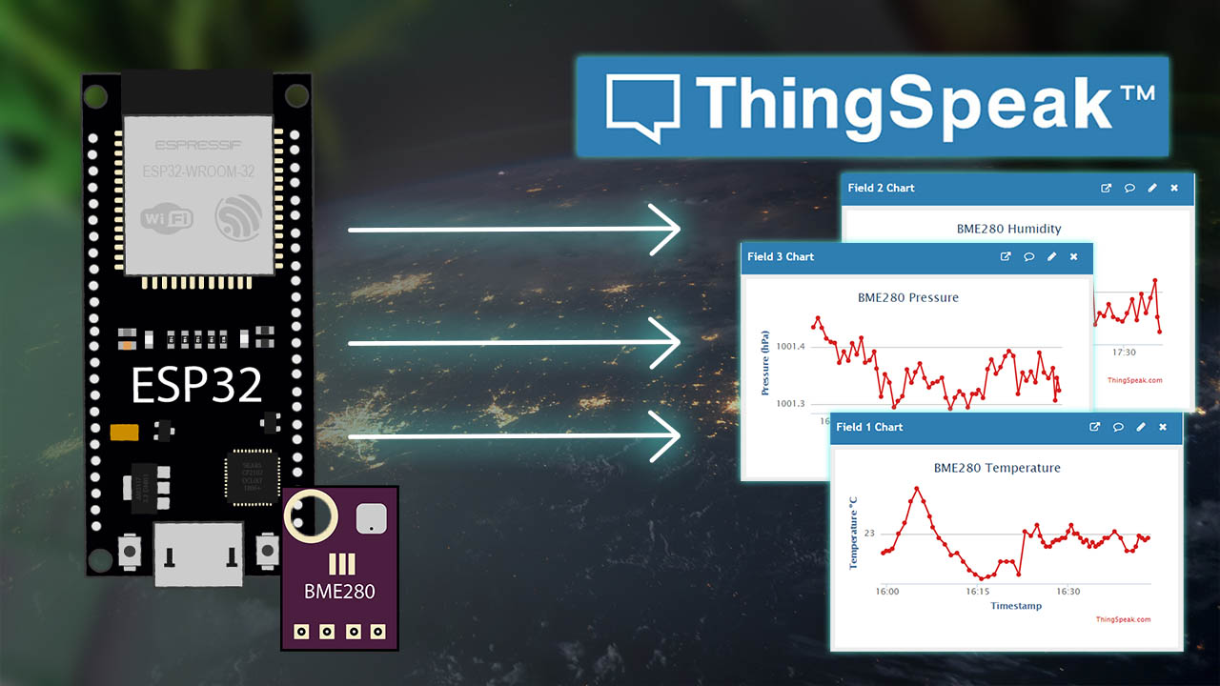
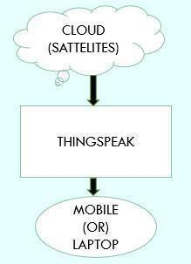
Software Requirements
Arduino IDE
The IDE we used here is Arduino IDE and the programming language
used as Embedded C
ThingsSpeak
ThingsSpeak is an IoT analytics platform service that allows you to aggregate
Visualize, and analyze live data streams in the cloud. You can send data to
ThingsSpeak from our device create instant visualization
Cloud Section

Slide 14
BLOCK DIAGRAM
POWER SUPPLY
MQ-2 SENSOR
ARDUINO UNO
WIFI MODULE
MQ-5 SENSOR
GSM
MQ-135 SENSOR
MQ-7 SENSOR
LCD DISPLAY
MQ- 8 SENSOR
BUZZER
DHT11 sensor
SERVO MOTOR
BMP 180 SENSOR
EXHAUSTING FAN

Slide 15
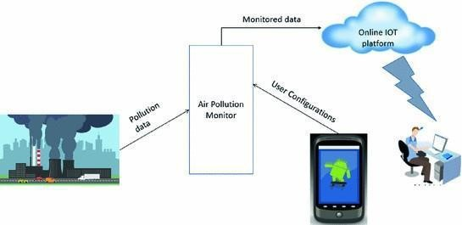
ARCHITECTURE

Slide 16
Working
An IoT-based air pollution monitoring system is a complex system that uses various technologies and components to measure, process, and visualize air pollution data. The following is a detailed explanation of the working process of such a system
Sensor deployment
The first step in setting up an IoT-based air pollution monitoring system is to deploy air pollution sensors. we are connected various gas sensors to the Arduino board based on the terminals
Data collection
Once the sensors are deployed, they start collecting air pollution data. This data is transmitted to a central database using internet connectivity, such as Wi-Fi, cellular. This enables real-time monitoring of air pollution levels and helps to identify spikes in pollution levels as they occur.
Data visualization
The processed data is visualized on a mobile app, allowing relevant authorities and the general public to access it easily. This information can be used to understand air pollution trends and patterns, and to make informed decisions about air quality management

Slide 17
Alarming system
The system includes an alarming mechanism that can be triggered when the levels of a certain pollutant exceed a predetermined threshold. This can alert relevant authorities and prompt them to take immediate action to mitigate the problem.
IoT-based air pollution monitoring system is designed to provide real-time air quality data and insights, allowing for timely and effective interventions to reduce air pollution

Slide 18
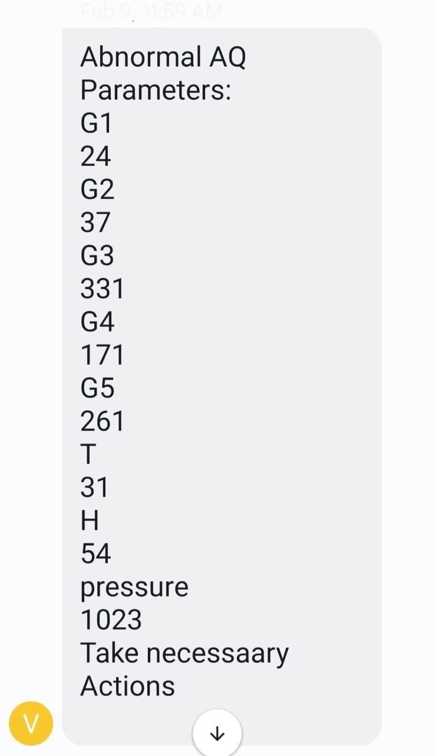
RESULTS
These are the Output showing on a display and the message send by GSM system as shown in figure above. If gases goes beyond threshold limit it sends alert message to take necessary actions

Slide 19
Applications
Industrial monitoring:
The system can be used to monitor air quality around industrial areas and help companies reduce their emissions and meet regulatory standards.
Health and safety monitoring:
The system can be used to monitor air quality in public places, schools, and hospitals to ensure the health and safety of people.
Environmental monitoring:
The system can be used to monitor air quality in real-time and provide early warning alerts to the public in case of hazardous air conditions.

Slide 20
Future Scope
The future scope of IoT based air pollution monitoring systems is vast and has the potential to be a game-changer in the field of environmental monitoring. Some potential advancements that could be made in an advanced version of the system include
Integration with smart city infrastructure: An IoT based air pollution monitoring system can be integrated with other smart city infrastructure such as traffic management systems, weather stations, and public transport systems. This can provide more accurate and real-time data on air quality and enable authorities to take preventive measures more effectively
Multi-sensor integration: An advanced version of the system can integrate multiple sensors that can detect a wide range of pollutants. This can provide a more comprehensive picture of air quality in the area.

Slide 21
Conclusion
The IoT-based air pollution monitoring system uses technology and sensors to measure air quality and provide real-time data to individuals, organizations, and governments. This helps to improve air quality and protect public health by providing accurate information that can be used to make informed decisions. The system is cost-effective, accurate, and can be easily scaled to cover large areas. The use of this technology is becoming increasingly important as the impact of air pollution on public health and the environment continues to grow.

Slide 22
References:-
1. https://securedstatic.greenpeace.org/india/Global/i ndia/Airpoclypse--Not-just-Delhi--Air-in-most- Indian-cities-hazardous--Greenpeace-report.pdf
2. content/uploads/2008/04/5v-regulator-using- 7805.JPG
3. https://store.arduino.cc/arduino-uno-rev3 [4]https://www.arduino.cc/
[5]https://www.aliexpress.com/item/1PCS-LOT- Solution-PH-valuo-Temperature-detector-sensor- module-for-arduino-Free- shipping/32620995019.html?spm=2114.4001

Slide 23
THANK YOU

